Slide 1
Converting ER Diagrams to Tables
Rule-01: For Strong Entity Set With Only Simple Attributes
A strong entity set with only simple attributes will require only one table in relational model.
Attributes of the table will be the attributes of the entity set.
The primary key of the table will be the key attribute of the entity set.

Slide 2
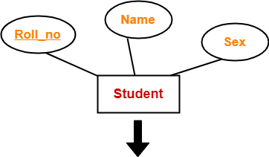
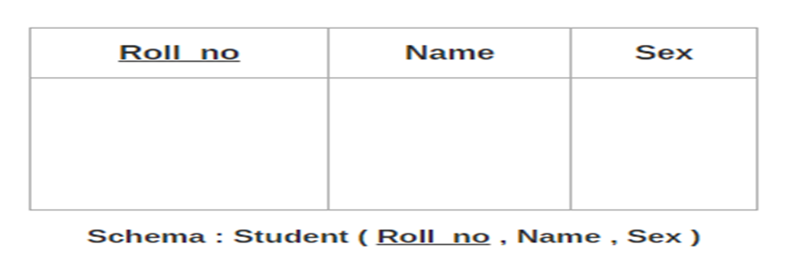
Converting ER Diagrams to Tables
Rule-01: For Strong Entity Set With Only Simple Attributes

Slide 3
Converting ER Diagrams to Tables
Rule-02: For Strong Entity Set With Composite Attributes
A strong entity set with any number of composite attributes will require only one table in relational model.
While conversion, subattributes of the composite attributes are taken into account and not the composite attribute itself.

Slide 4
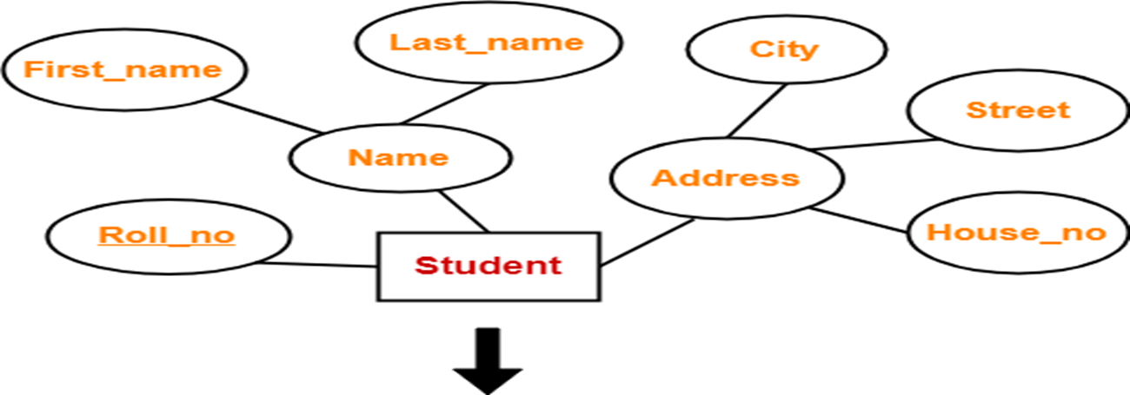
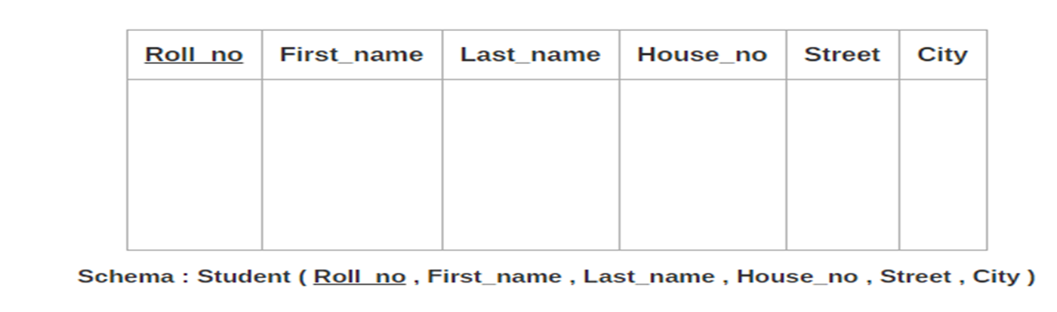
Converting ER Diagrams to Tables
Rule-02: For Strong Entity Set With Composite Attributes

Slide 5
Converting ER Diagrams to Tables
Rule-03: For Strong Entity Set With Multi Valued Attributes
A strong entity set with any number of multi valued attributes will require two tables in relational model.
One table will contain all the simple attributes with the primary key.
Other table will contain the primary key and all the multi valued attributes.

Slide 6
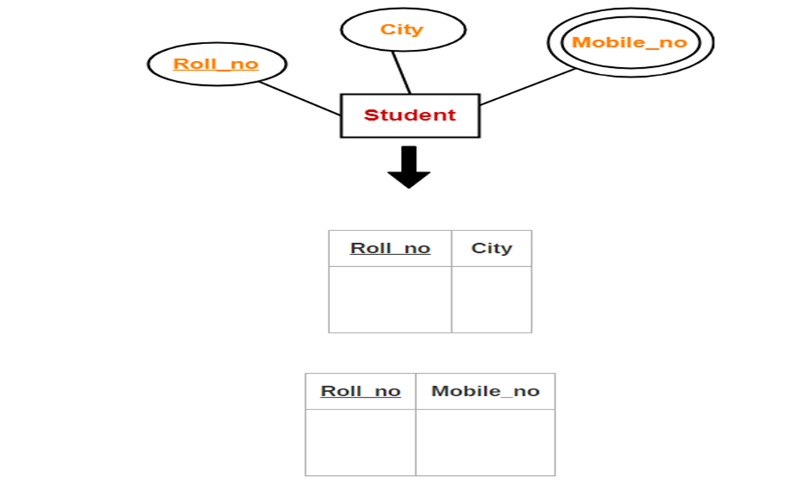
Converting ER Diagrams to Tables
Rule-03: For Strong Entity Set With Multi Valued Attributes

Slide 7
Converting ER Diagrams to Tables
Rule-04: Translating Relationship Set into a Table
A relationship set will require one table in the relational model.
Attributes of the table are-
Primary key attributes of the participating entity sets
Its own descriptive attributes if any.

Slide 8
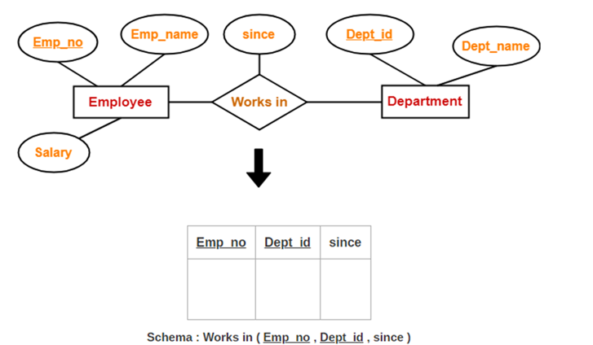
Converting ER Diagrams to Tables
Rule-04: Translating Relationship Set into a Table

Slide 9
Converting ER Diagrams to Tables
Rule-04: Translating Relationship Set into a Table
NOTE-
If we consider the overall ER diagram, three tables will be required in relational model-
One table for the entity set “Employee”
One table for the entity set “Department”
One table for the relationship set “Works in”

Slide 10
Converting ER Diagrams to Tables
Rule-05: For Binary Relationships With Cardinality Ratios
The following four cases are possible-
Case-01: Binary relationship with cardinality ratio m:n
Case-02: Binary relationship with cardinality ratio 1:n
Case-03: Binary relationship with cardinality ratio m:1
Case-04: Binary relationship with cardinality ratio 1:1

Slide 11
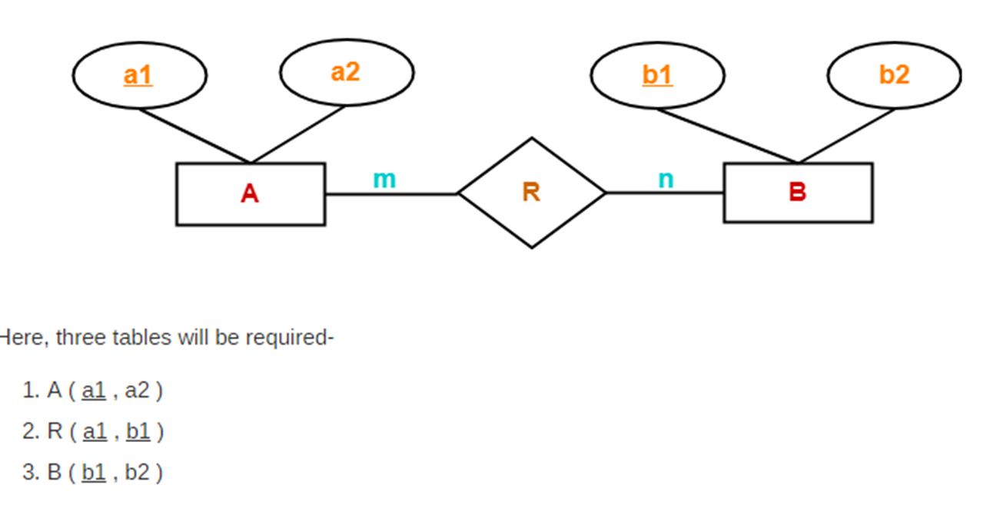
Converting ER Diagrams to Tables
Rule-05: For Binary Relationships With Cardinality Ratios
Case-01: Binary relationship with cardinality ratio m:n

Slide 12
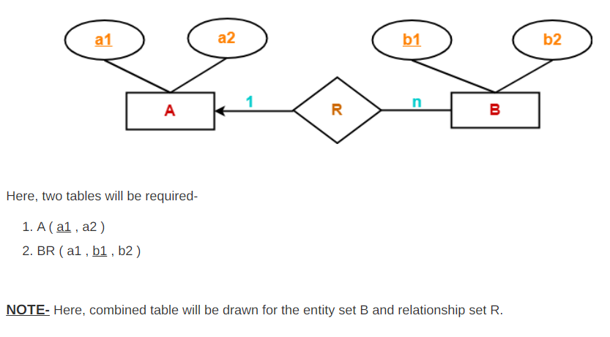
Converting ER Diagrams to Tables
Rule-05: For Binary Relationships With Cardinality Ratios
Case-02: Binary relationship with cardinality ratio 1:n

Slide 13
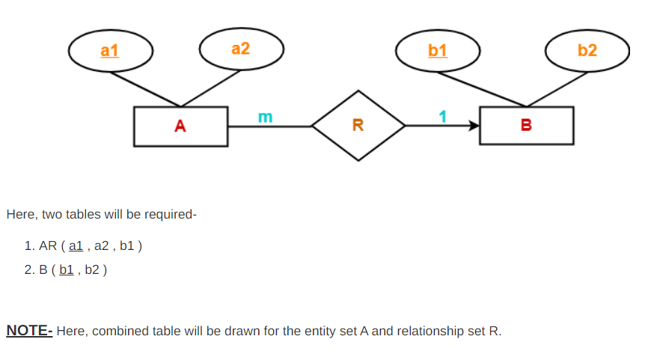
Converting ER Diagrams to Tables
Rule-05: For Binary Relationships With Cardinality Ratios
Case-03: Binary relationship with cardinality ratio m:1

Slide 14
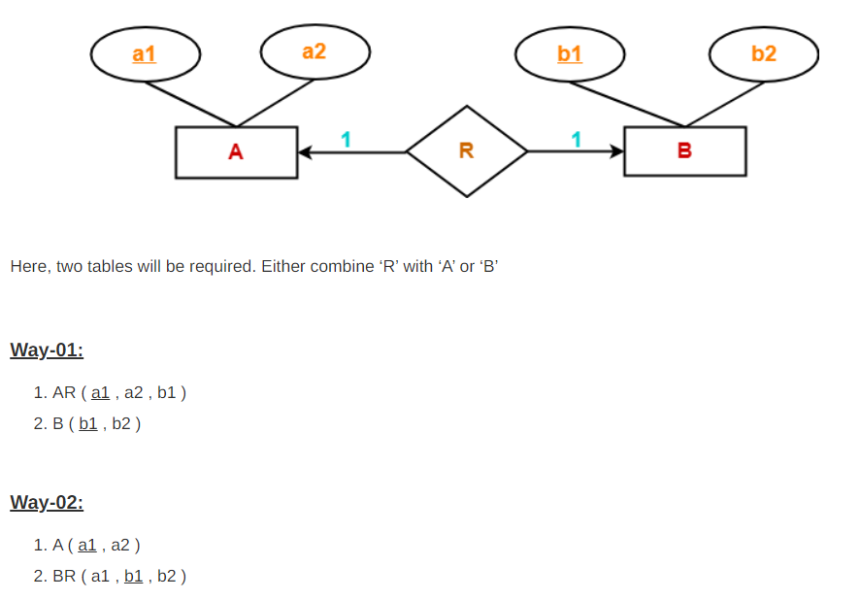
Converting ER Diagrams to Tables
Rule-05: For Binary Relationships With Cardinality Ratios
Case-04: Binary relationship with cardinality ratio 1:1

Slide 15
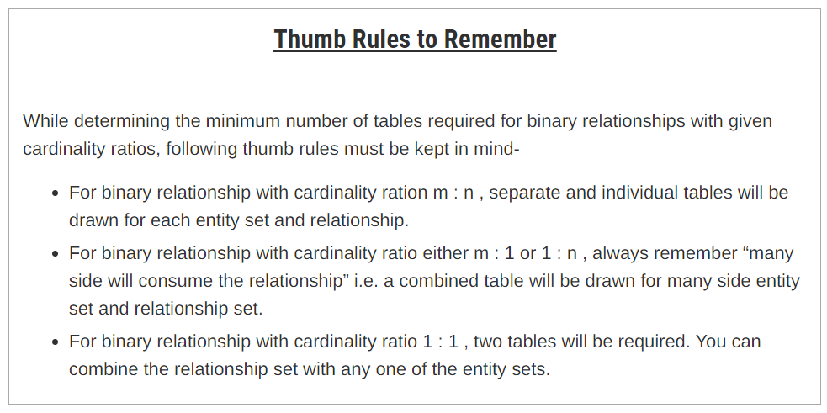
Converting ER Diagrams to Tables

Slide 16
Converting ER Diagrams to Tables
Rule-06: For Binary Relationship With Both Cardinality Constraints and Participation Constraints
Cardinality constraints will be implemented as discussed in Rule-05.
Because of the total participation constraint, foreign key acquires NOT NULL constraint i.e. now foreign key can not be null.

Slide 17
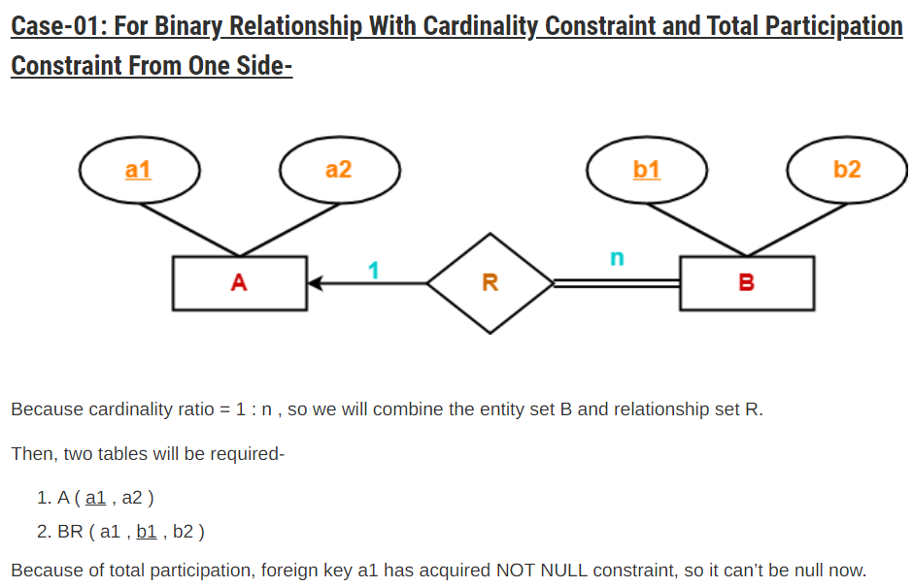
Converting ER Diagrams to Tables
Rule-06: For Binary Relationship With Both Cardinality Constraints and Participation Constraints

Slide 18
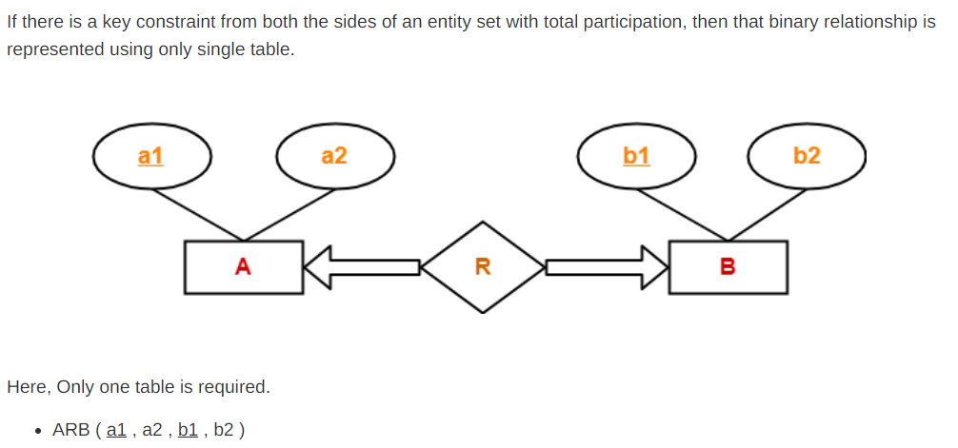
Converting ER Diagrams to Tables
Rule-06: For Binary Relationship With Both Cardinality Constraints and Participation Constraints

Slide 19
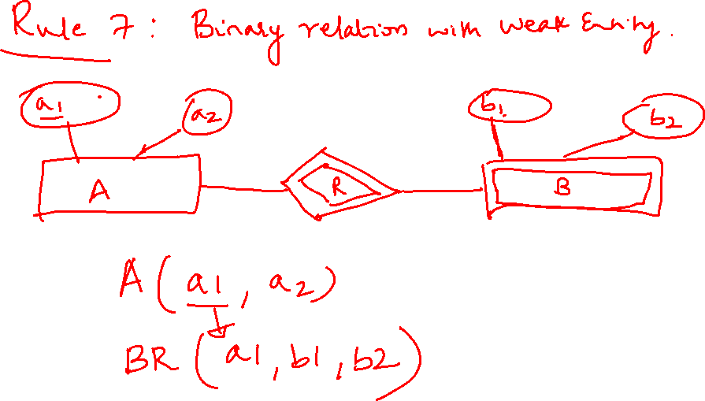

Slide 20
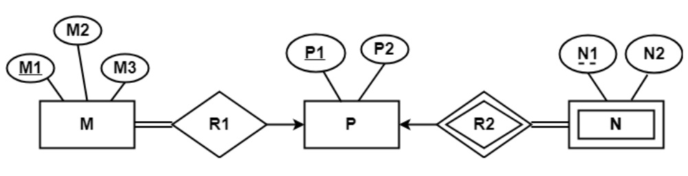
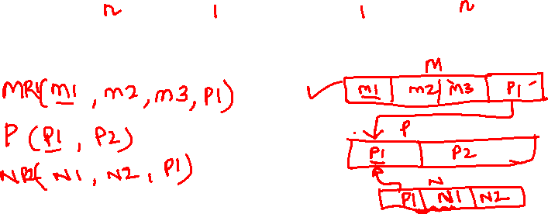
Converting ER Diagrams to Tables
Problem-01:
Find the minimum number of tables required for the following ER diagram in relational model

Slide 21
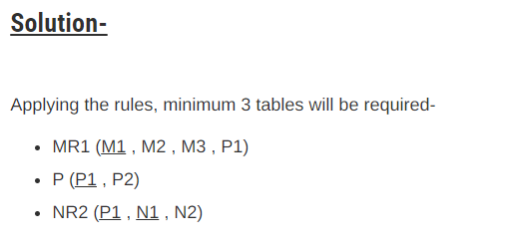
Converting ER Diagrams to Tables
Problem-01:

Slide 22
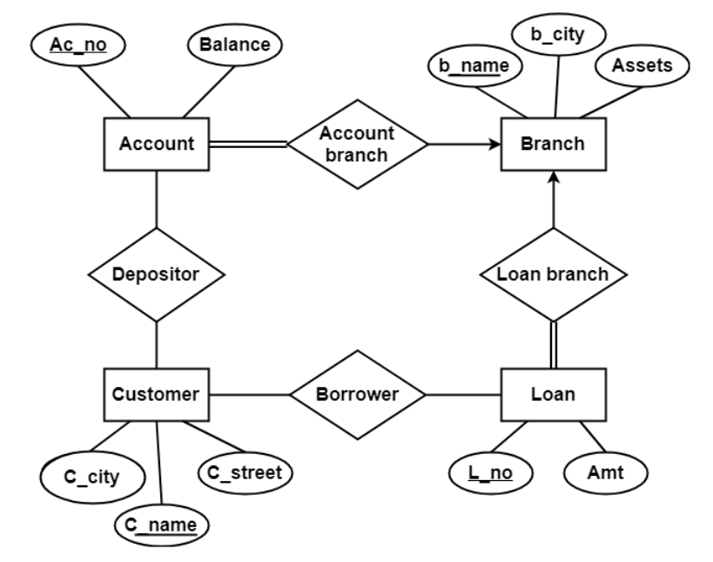
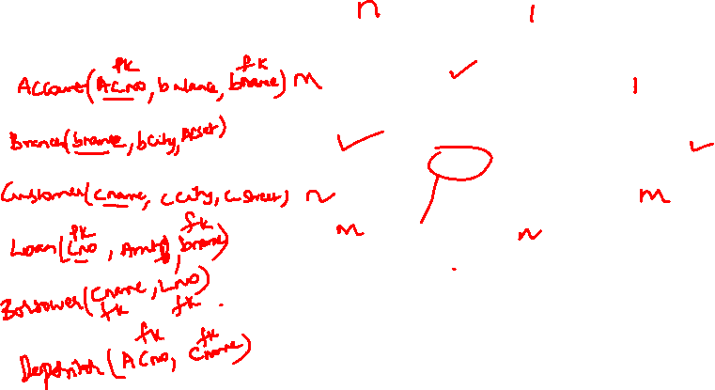
Converting ER Diagrams to Tables
Problem-02:

Slide 23
Converting ER Diagrams to Tables
Problem-02:
Solution-
Applying the rules that we have learnt, minimum 6 tables will be required-
Account (Ac_no , Balance , b_name)
Branch (b_name , b_city , Assets)
Loan (L_no , Amt , b_name)
Borrower (C_name , L_no)
Customer (C_name , C_street , C_city)
Depositor (C_name , Ac_no)

Slide 24
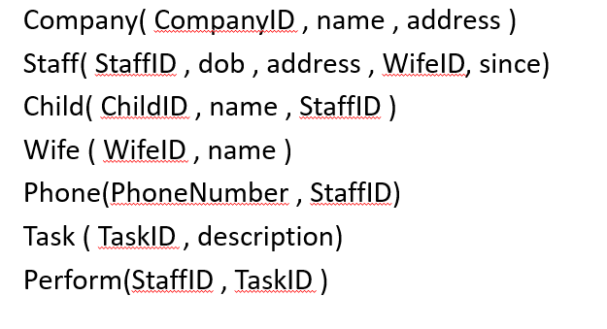
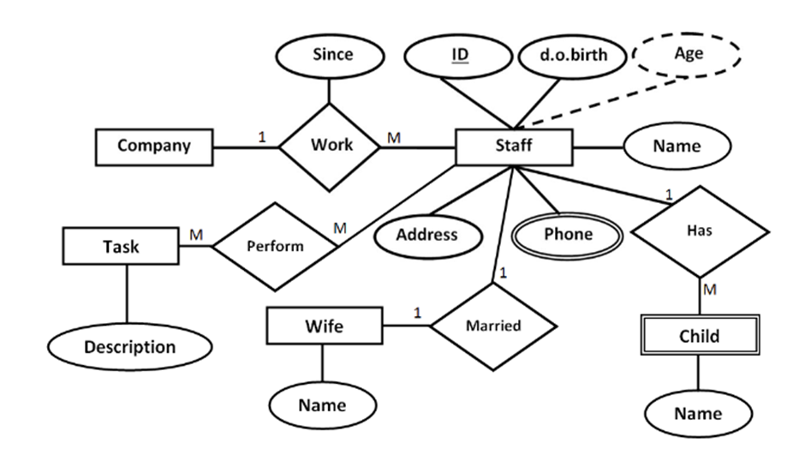
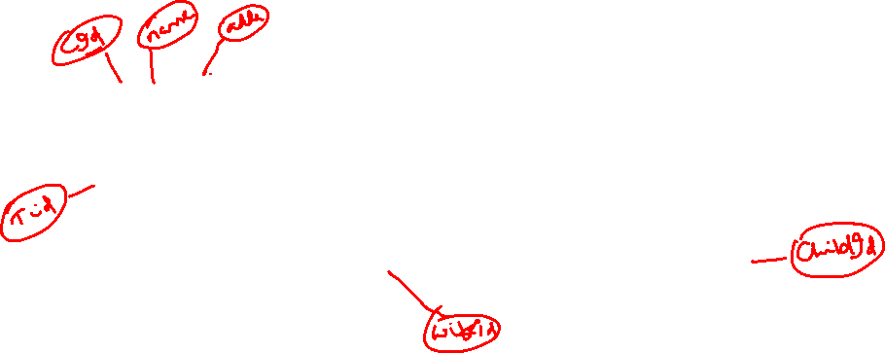
Converting ER Diagrams to Tables
Problem-03:

Slide 25
Converting ER Diagrams to Tables
Problem-03:
The relational schema for the ER Diagram is given below as:
Company( CompanyID , name , address )
Staff( StaffID , dob , address , WifeID, since,CompanyID)
Child( ChildID , name , StaffID )
Wife ( WifeID , name )
Phone(PhoneNumber , StaffID)
Task ( TaskID , description)
Perform(StaffID , TaskID )

Slide 26
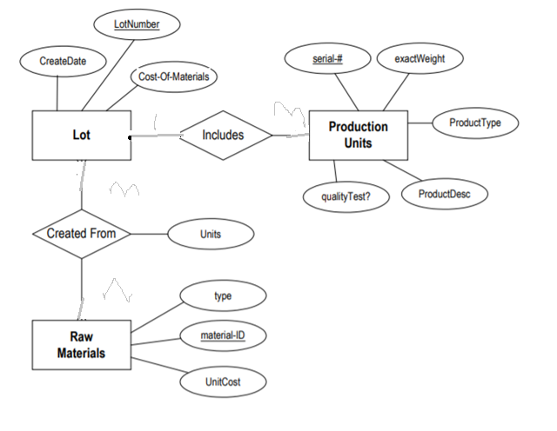
Converting ER Diagrams to Tables
Problem-04:

Slide 27
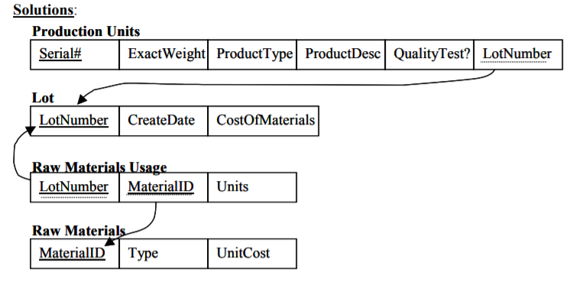
Converting ER Diagrams to Tables
Problem-04:

Slide 28
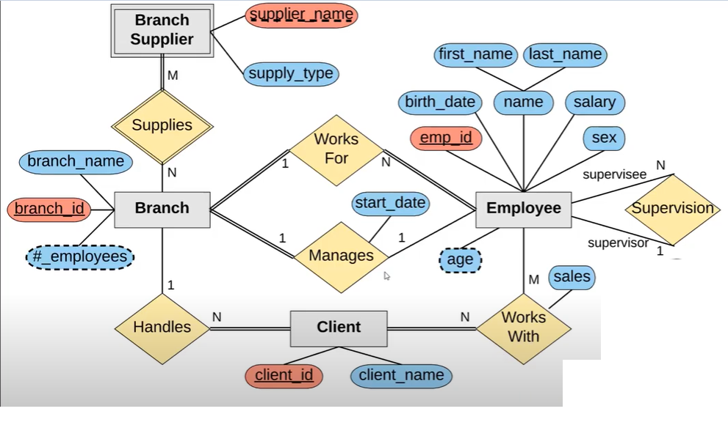
Converting ER Diagrams to Tables
Problem 5:

Slide 29
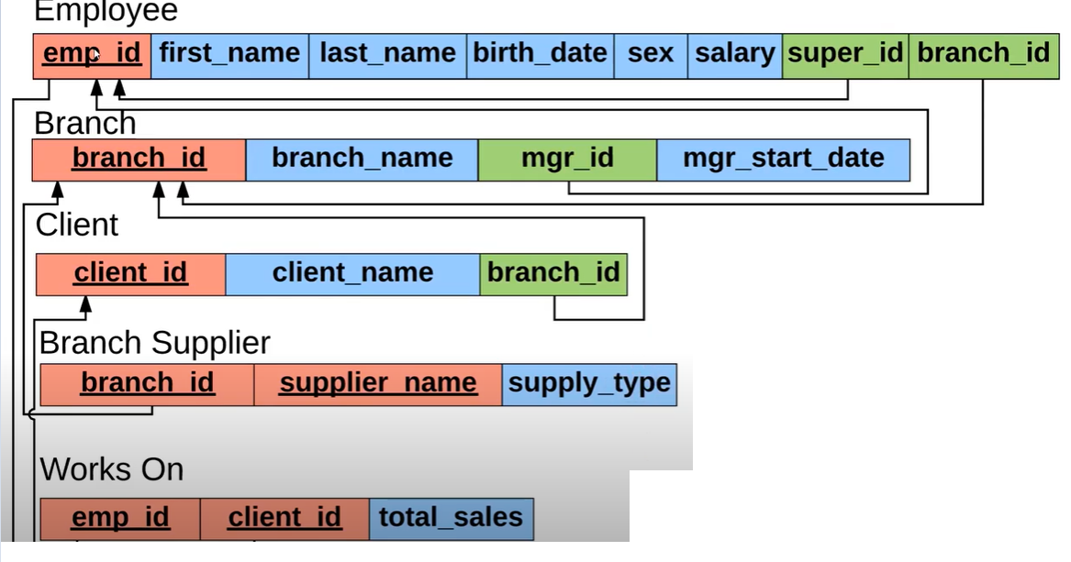
Converting ER Diagrams to Tables
Problem 5:

Slide 30
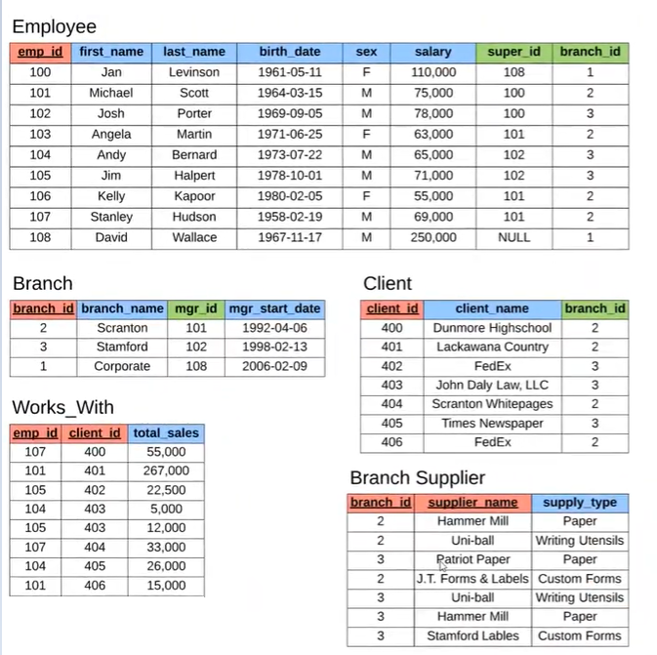
Converting ER Diagrams to Tables
Problem 5:

Slide 31
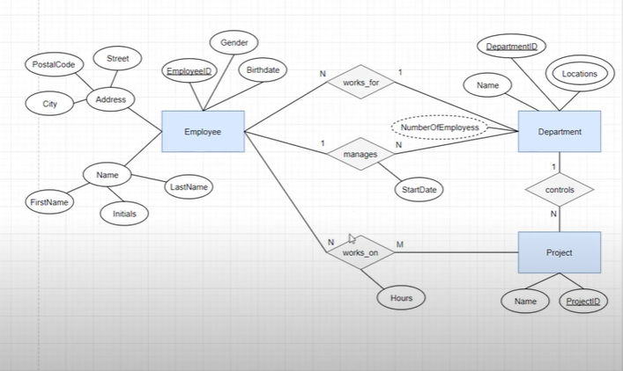
Converting ER Diagrams to Tables
Problem 6:

